Slide 1




Scalable Deep Learning with CNN on HPC Infrastructure
Dr. Aleksandra Rančić

Slide 2
Session 1. Introduction to Convolutional Neural Networks (CNNs)
1. What are CNNs and their evolution
CNNs = a class of deep neural networks
Process grid-like structured data: images (2D grids) or time series (1D grids)
Use convolutional layers to automatically extract hierarchical spatial features
Inspired by the visual cortex = neurons respond to overlapping regions of the visual field
CNN architectue = input layer, Convolutional layer, Pooling layer, and fully connected layers.
Convolutional layer
Max pooling layer
Dense layer
Input layer
Output layer
Image

Slide 3
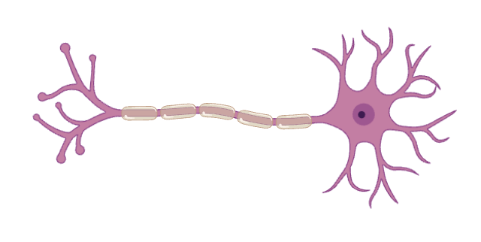
Introduction to Neural Networks
Neural Networks are the building blocks of deep learning systems.
How do our brains subconsciously perform complex pattern recognition tasks each and every day?
We have a real-life biological neural network connected to our nervous systems, and it is made up of interconnected neurons.
Terminal buttons (connections to other neurons)
Dendrite (inputs)
Axon (outputs)
Nucleus (activation function)
Soma (cell body – neuron
computation; weighted sum + activation)
Human neural cell - neuron
Artificial Neural Network is a computation system that attempts to mimic the neural connection in our nervous system.

Slide 4
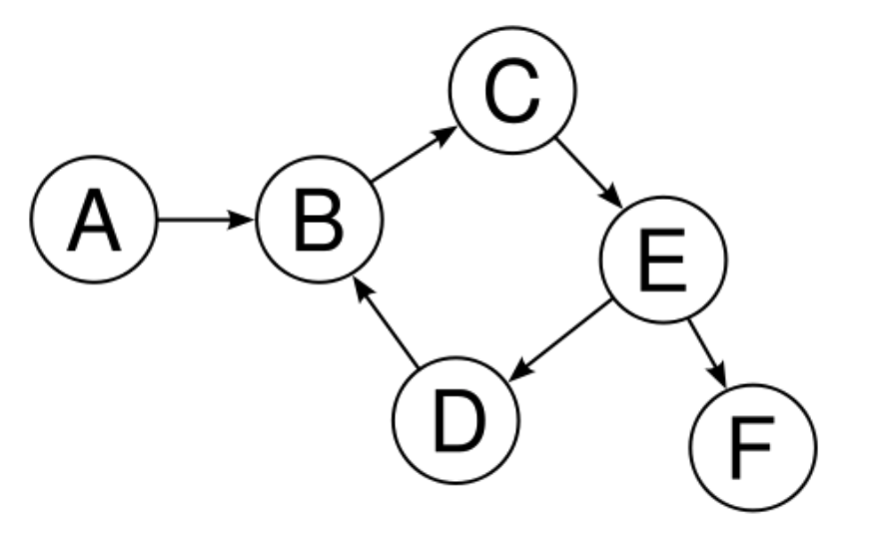
A Neural Network (NN) is like a connected system of points, where:
Each point (called a node or neuron) does a small calculation;
The connections (called edges) between them show which nodes send information to others.
The connections have directions –information flows from one node to the next.
This forms a directed graph – a structure made of connected parts where data flows in one direction.
For something to be called a NN, it needs:
Nodes that do calculations
Connection showing how data flows
A structure that connects everything in layers
Neural networks are built using concepts from graph theory;
They are directed graphs where nodes (neurons) do computations and edges (connections) carry weighted signals;

Slide 5



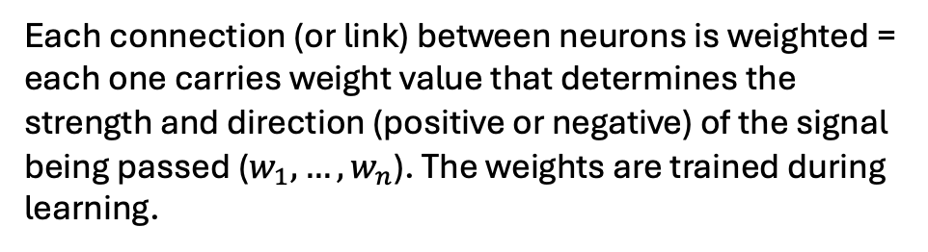



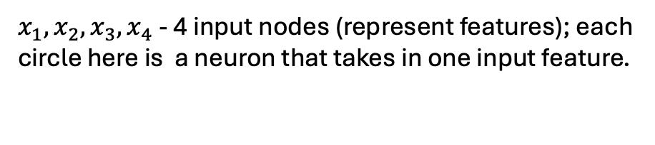






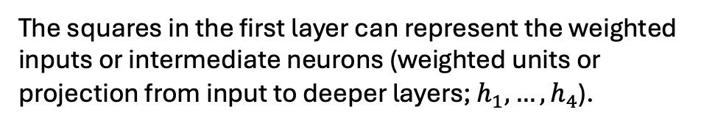


Input
$x_{1}, x_{2},x_{3},x_{4}$ - 4 input nodes (represent features); each circle here is a neuron that takes in one input feature.
$$x_{1}$$
$$w_{1}$$
$$h_{1}$$
Each input node is connected to one square, showing 1:1 mapping
$$w_{2}$$
$$h_{5}$$
$$x_{2}$$
$$h_{2}$$
Output
Each connection (or link) between neurons is weighted = each one carries weight value that determines the strength and direction (positive or negative) of the signal being passed ($w_{1}, …, w_{n}$). The weights are trained during learning.
$$h_{6}$$
$$\hat{y}$$
$$x_{3}$$
$$h_{3}$$
$$h_{7}$$
$$h_{4}$$
$$x_{4}$$
The squares in the first layer can represent the weighted inputs or intermediate neurons (weighted units or projection from input to deeper layers; $h_{1}, …, h_{4}$).
Hidden layers
The third column – the second hidden layer – three squares form a true hidden layer, where each node receives input from multiple previous nodes. In this layer, complex combinations of features are learned.
A multi-layer feedforward neural network
Output layer = the final prediction/output node, which gives the final results

Slide 6
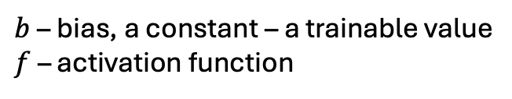

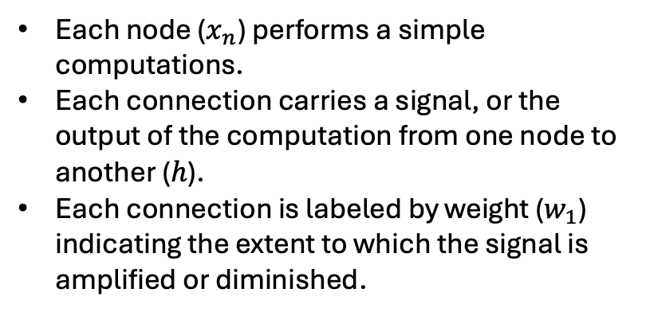
Input
Each node ($x_{n}$) performs a simple computations.
Each connection carries a signal, or the output of the computation from one node to another ($h$).
Each connection is labeled by weight ($w_{1}$) indicating the extent to which the signal is amplified or diminished.
$$x_{1}$$
$$w_{1}$$
$$h_{1}$$
$$w_{2}$$
$$h_{5}$$
$$x_{2}$$
$$h_{2}$$
Output
$$h_{6}$$
$$\hat{y}$$
$$x_{3}$$
$$h_{3}$$
$$h_{7}$$
$$h_{4}$$
$$x_{4}$$
$$h=f\left(\sum{\left(w_{i}x_{i}\right)}+b\right)=f(net)$$
Hidden layers
A multi-layer feedforward neural network
$b$ – bias, a constant – a trainable value
$f$ – activation function

Slide 7
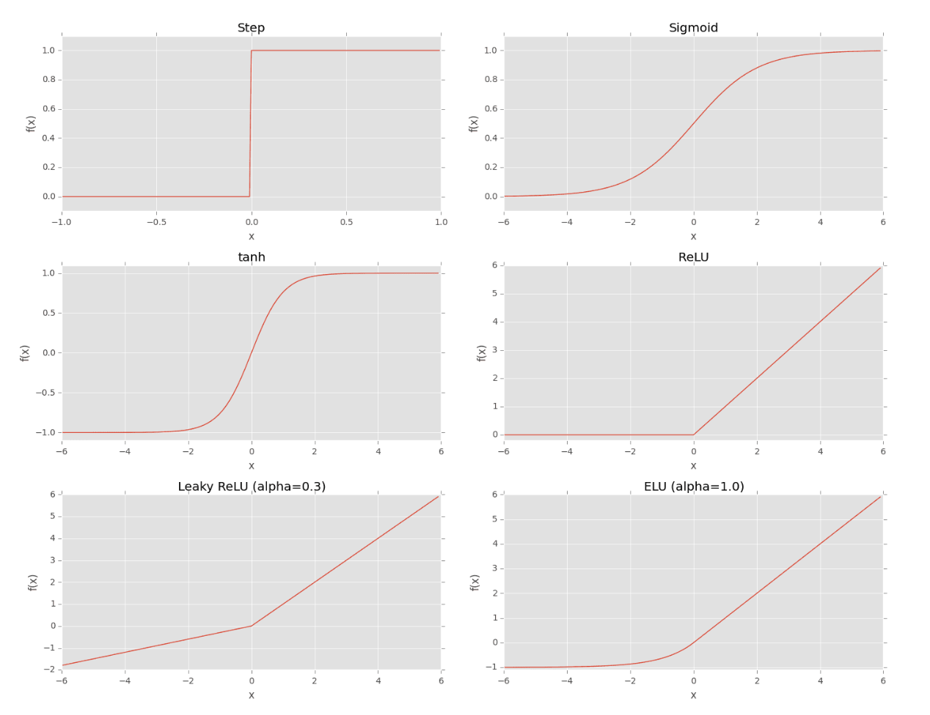
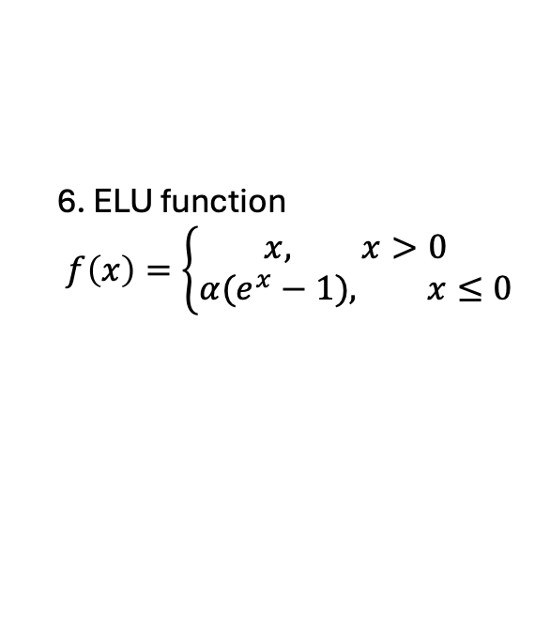
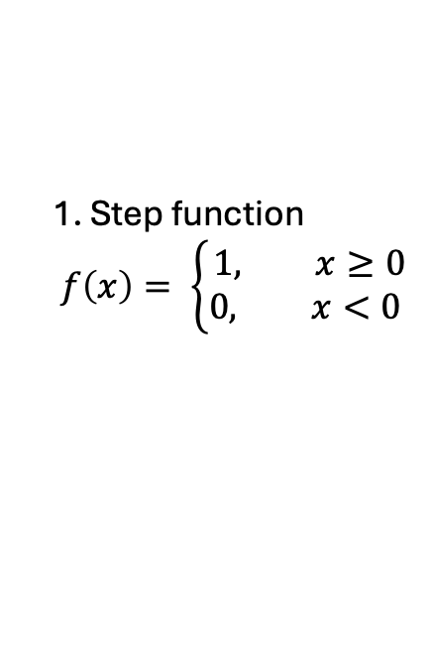
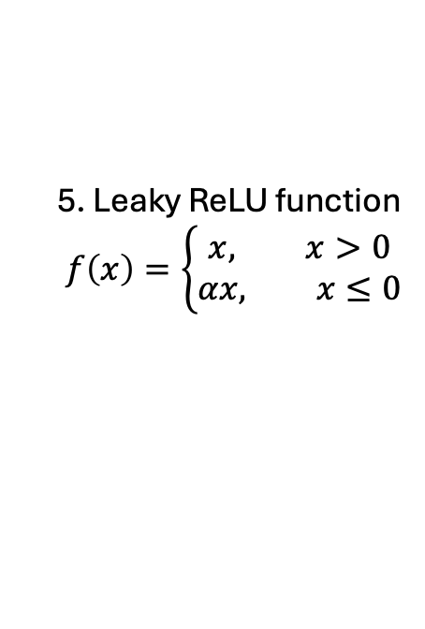
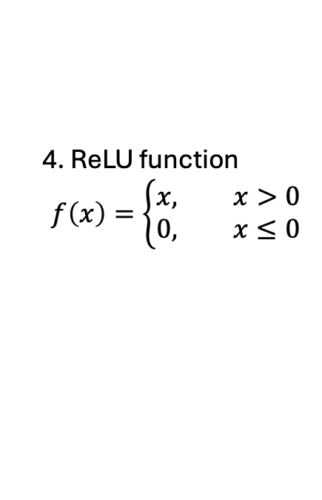
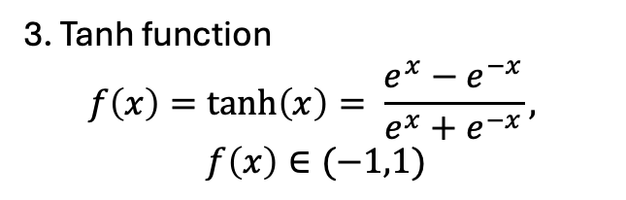
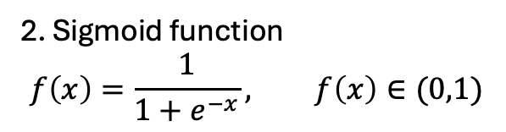
Activation functions
1. Step function
$$f\left(x\right)= \left\{\begin{aligned}1, x≥0 \\ 0, x<0 \end{aligned}\right.$$
1
2
2. Sigmoid function
$$f\left(x\right)=\frac{1}{1+e^{−x}}, f\left(x\right)∈(0,1)$$
3. Tanh function
$$f\left(x\right)=\tanh\left(x\right)= \frac{e^{x}−e^{−x}}{e^{x}+e^{−x}},$$
$$f\left(x\right)∈(−1,1)$$
3
4
4. ReLU function
$$f\left(x\right)=\left\{\begin{aligned}x, x>0 \\ 0, x≤0\end{aligned}\right.$$
5. Leaky ReLU function
$$f\left(x\right)=\left\{\begin{aligned}x, x>0 \\ αx, x≤0\end{aligned}\right.$$
5
6
6. ELU function
$$f\left(x\right)=\left\{\begin{aligned}x, x>0 \\ α(e^{x}−1), x≤0\end{aligned}\right.$$

Slide 8
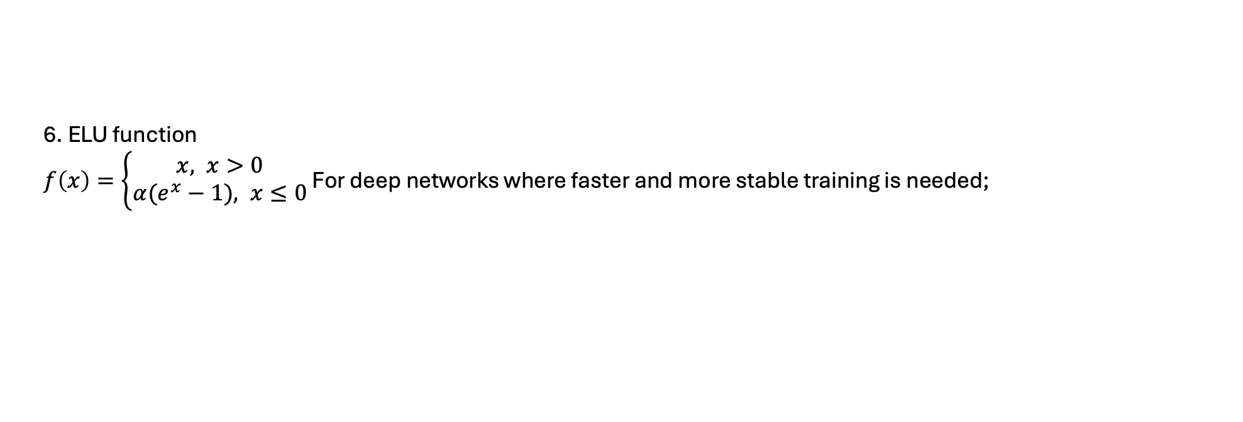
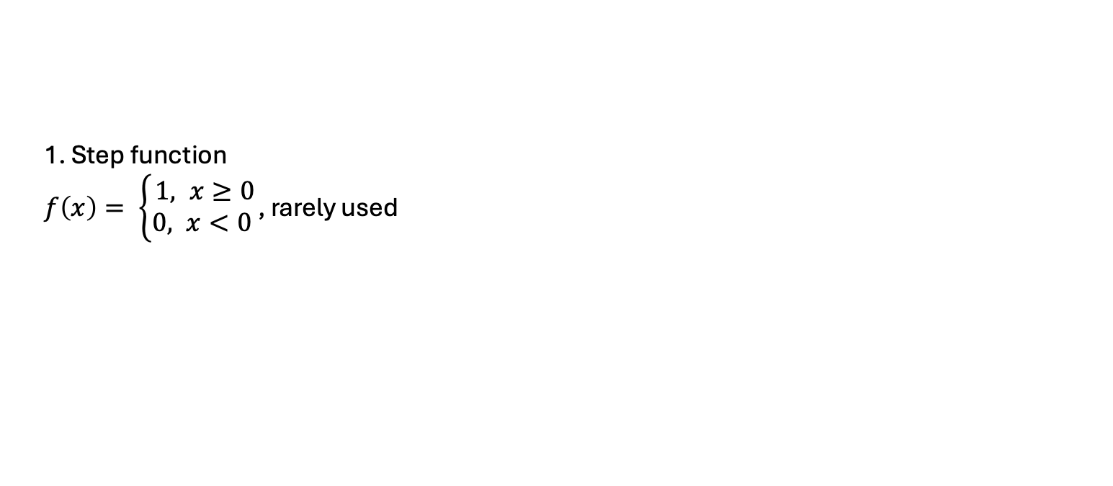
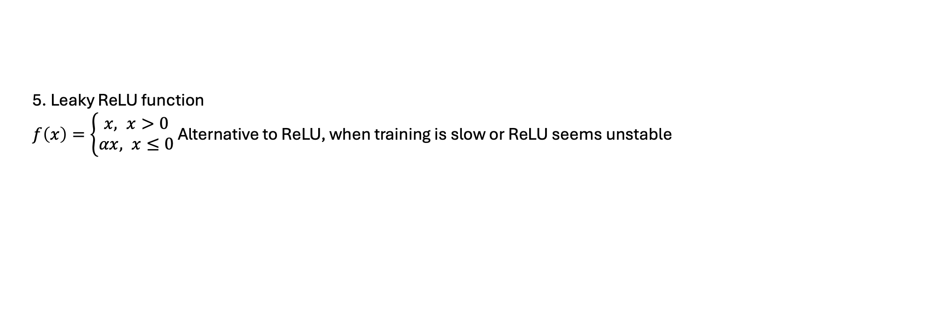
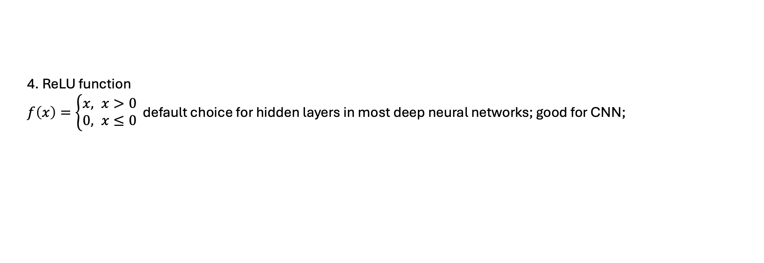
Activation functions
1. Step function
$f\left(x\right)= \left\{\begin{aligned}1, x≥0 \\ 0, x<0 \end{aligned}\right.$, rarely used
2. Sigmoid function
$f\left(x\right)=\frac{1}{1+e^{−x}}, f\left(x\right)∈\left(0,1\right)$ ; When you want a probability between 0 and 1
3. Tanh function
$f\left(x\right)=\tanh\left(x\right)= \frac{e^{x}−e^{−x}}{e^{x}+e^{−x}},$ used in hidden layers
$f\left(x\right)∈(−1,1)$
4. ReLU function
$f\left(x\right)=\left\{\begin{aligned}x, x>0 \\ 0, x≤0\end{aligned}\right.$ default choice for hidden layers in most deep neural networks; good for CNN;
5. Leaky ReLU function
$f\left(x\right)=\left\{\begin{aligned}x, x>0 \\ αx, x≤0\end{aligned}\right.$ Alternative to ReLU, when training is slow or ReLU seems unstable
6. ELU function
$f\left(x\right)=\left\{\begin{aligned}x, x>0 \\ α(e^{x}−1), x≤0\end{aligned}\right.$ For deep networks where faster and more stable training is needed;

Slide 9















Input
$$x_{1}$$
$$w_{1}$$
This type of neural network with multi layers has forward propagation;
Forward propagation is computationally straightforward;
Poor predictions, since the weights and biases are randomly initialized;
$$h_{1}$$
$$w_{2}$$
$$h_{5}$$
$$x_{2}$$
$$h_{2}$$
Output
$$h_{6}$$
$$\hat{y}$$
$$x_{3}$$
$$h_{3}$$
$$h_{7}$$
$$h_{4}$$
$$x_{4}$$
Hidden layers
$$h=f\left(\sum{\left(w_{i}x_{i}\right)}+b\right)=f(net)$$

Slide 10
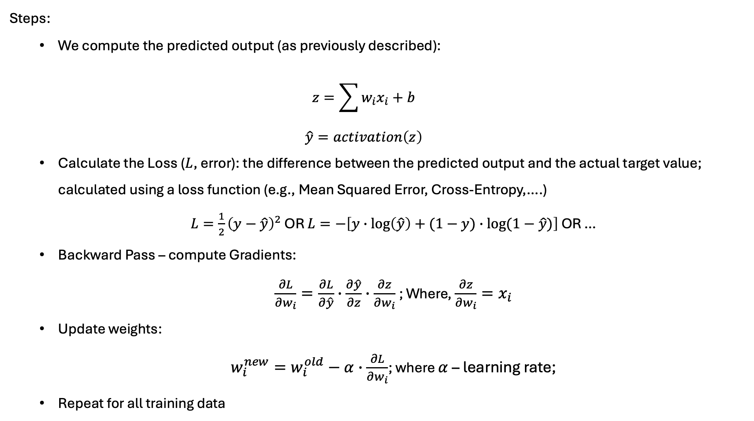
Backward propagation – learning from errors
This is one EPOCH
Steps:
  We compute the predicted output (as previously described):
  $$z=\sum{w_{i}x_{i}+b}$$
  $$\hat{y}=activation\left(z\right)$$
  Calculate the Loss ($L$, error): the difference between the predicted output and the actual target value; calculated using a loss function (e.g., Mean Squared Error, Cross-Entropy,….)
  $L=\frac{1}{2}{\left(y−\hat{y}\right)}^{2}$ OR $L=−\left[y∙\log\left(\hat{y}\right)+(1−y)∙log⁡(1−\hat{y})\right]$ OR …
  Backward Pass – compute Gradients:
  $\frac{∂L}{∂w_{i}}=\frac{∂L}{∂\hat{y}}∙\frac{∂\hat{y}}{∂z}∙\frac{∂z}{∂w_{i}}$; Where, $\frac{∂z}{∂w_{i}}=x_{i}$
  Update weights:
  $w_{i}^{new}=w_{i}^{old}−α∙\frac{∂L}{∂w_{i}}$; where $α$ – learning rate;
  Repeat for all training data

Slide 11
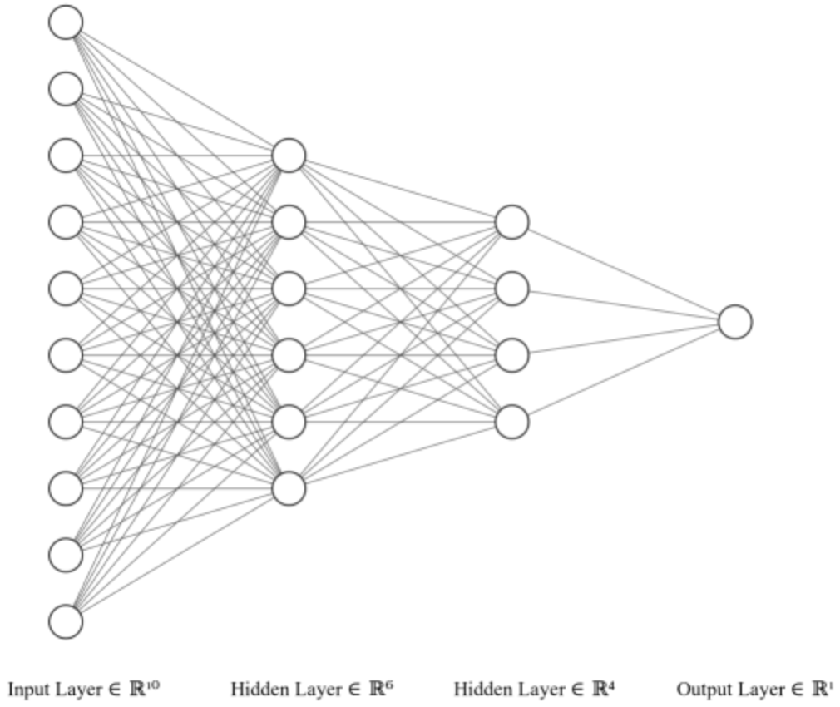
Neural Networks – A Multi-Level Perceptron
Forward propagation
Backward propagation
Input Layer
Hidden Layer 1
Hidden Layer 2
Output Layer

Slide 12
But what is happening in convolutional layer?
Convolutional layer
Max pooling layer
Dense layer
Input layer
Output layer
Image

Slide 13
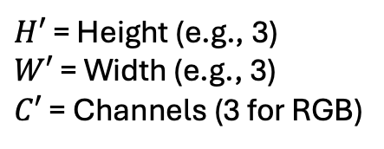
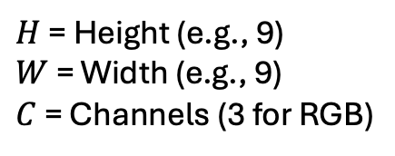
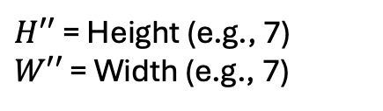
Convolution
Kernels
Feature maps
Input image
3 color chanels
Height
pixels
Width pixels
$H$ = Height (e.g., 9)
$W$ = Width (e.g., 9)
$C$ = Channels (3 for RGB)
$H′$ = Height (e.g., 3)
$W′$ = Width (e.g., 3)
$C′$ = Channels (3 for RGB)
$H′′$ = Height (e.g., 7)
$W′′$ = Width (e.g., 7)
(9 x 9 x 3)

Slide 14
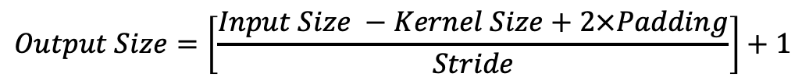
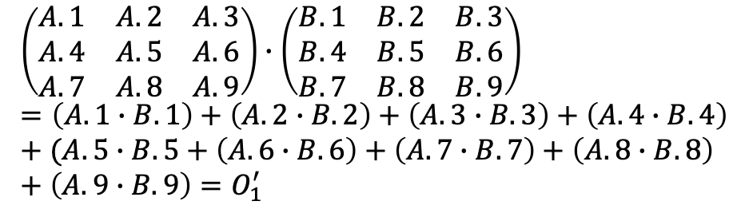
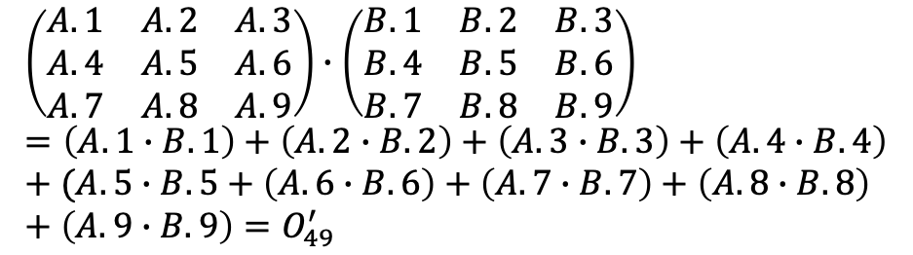
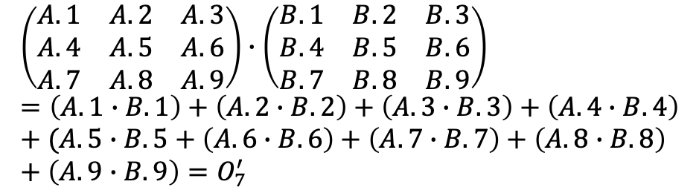
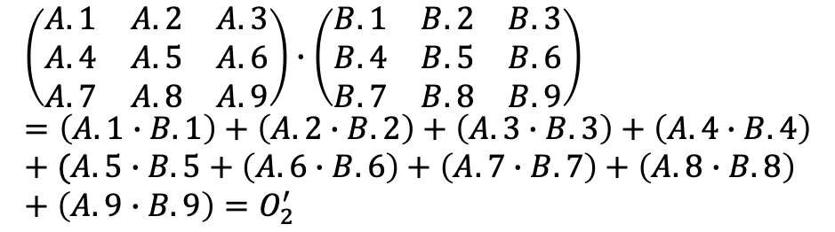
$$\left(\begin{matrix}A.1 & A.2 & A.3 \\ A.4 & A.5 & A.6 \\ A.7 & A.8 & A.9\end{matrix}\right)∙\left(\begin{matrix}B.1 & B.2 & B.3 \\ B.4 & B.5 & B.6 \\ B.7 & B.8 & B.9\end{matrix}\right)=\left(A.1∙B.1\right)+\left(A.2∙B.2\right)+\left(A.3∙B.3\right)+\left(A.4∙B.4\right)+(A.5∙B.5+\left(A.6∙B.6\right)+\left(A.7∙B.7\right)+\left(A.8∙B.8\right)+\left(A.9∙B.9\right)=O_{2}^{′}$$
 | 0
…
$$\left(\begin{matrix}A.1 & A.2 & A.3 \\ A.4 & A.5 & A.6 \\ A.7 & A.8 & A.9\end{matrix}\right)∙\left(\begin{matrix}B.1 & B.2 & B.3 \\ B.4 & B.5 & B.6 \\ B.7 & B.8 & B.9\end{matrix}\right)=\left(A.1∙B.1\right)+\left(A.2∙B.2\right)+\left(A.3∙B.3\right)+\left(A.4∙B.4\right)+(A.5∙B.5+\left(A.6∙B.6\right)+\left(A.7∙B.7\right)+\left(A.8∙B.8\right)+\left(A.9∙B.9\right)=O_{7}^{′}$$
…
$$\left(\begin{matrix}A.1 & A.2 & A.3 \\ A.4 & A.5 & A.6 \\ A.7 & A.8 & A.9\end{matrix}\right)∙\left(\begin{matrix}B.1 & B.2 & B.3 \\ B.4 & B.5 & B.6 \\ B.7 & B.8 & B.9\end{matrix}\right)=\left(A.1∙B.1\right)+\left(A.2∙B.2\right)+\left(A.3∙B.3\right)+\left(A.4∙B.4\right)+(A.5∙B.5+\left(A.6∙B.6\right)+\left(A.7∙B.7\right)+\left(A.8∙B.8\right)+\left(A.9∙B.9\right)=O_{49}^{′}$$
$$\left(\begin{matrix}A.1 & A.2 & A.3 \\ A.4 & A.5 & A.6 \\ A.7 & A.8 & A.9\end{matrix}\right)∙\left(\begin{matrix}B.1 & B.2 & B.3 \\ B.4 & B.5 & B.6 \\ B.7 & B.8 & B.9\end{matrix}\right)=\left(A.1∙B.1\right)+\left(A.2∙B.2\right)+\left(A.3∙B.3\right)+\left(A.4∙B.4\right)+(A.5∙B.5+\left(A.6∙B.6\right)+\left(A.7∙B.7\right)+\left(A.8∙B.8\right)+\left(A.9∙B.9\right)=O_{1}^{′}$$
$$Output Size=\left[\frac{Input Size −Kernel Size+2×Padding}{Stride}\right]+1$$

Slide 15
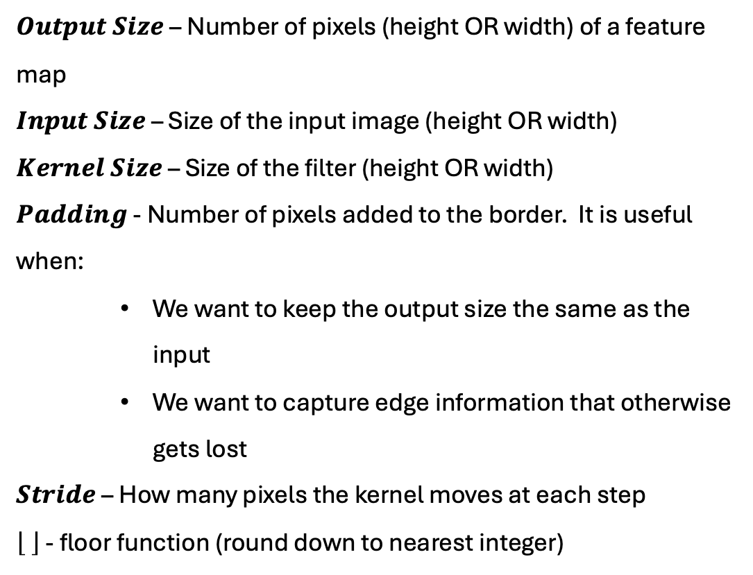
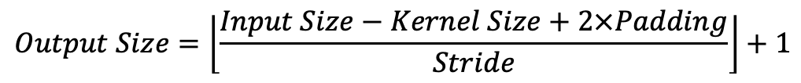
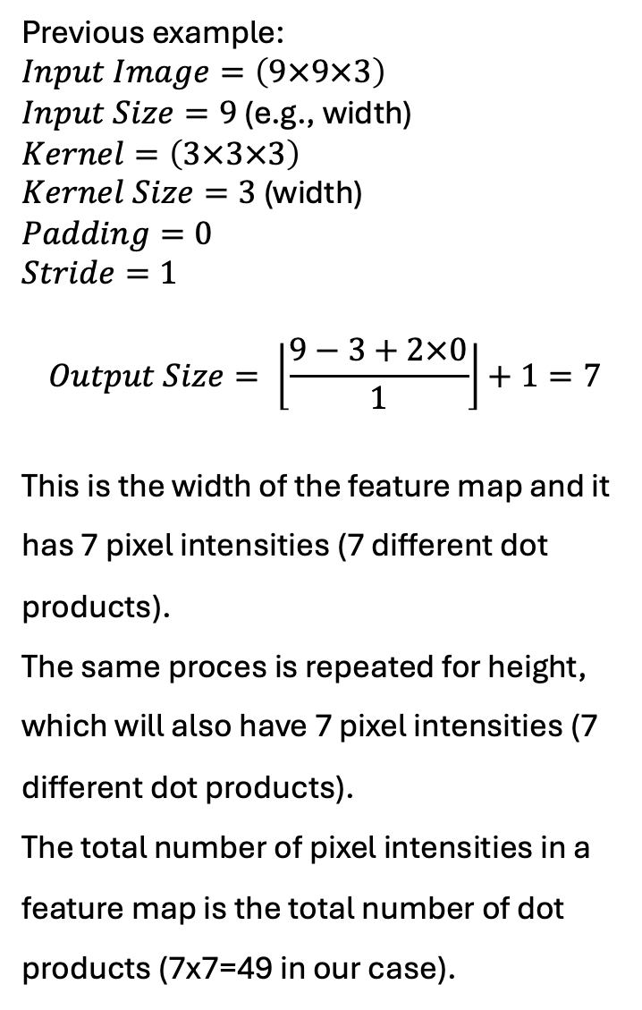
Previous example:
$Input Image=\left(9×9×3\right)$
$Input Size=9$ (e.g., width)
$Kernel=\left(3×3×3\right)$
$Kernel Size=3$ (width)
$Padding=0$
$Stride=1$
$$Output Size= \left\lfloor \frac{9−3+2×0}{1}\right\rfloor +1=7$$
This is the width of the feature map and it has 7 pixel intensities (7 different dot products).
The same proces is repeated for height, which will also have 7 pixel intensities (7 different dot products).
The total number of pixel intensities in a feature map is the total number of dot products (7x7=49 in our case).
$$Output Size=\left\lfloor \frac{Input Size−Kernel Size+2×Padding}{Stride}\right\rfloor +1$$
$Output Size$ – Number of pixels (height OR width) of a feature map
$Input Size$ – Size of the input image (height OR width)
$Kernel Size$ – Size of the filter (height OR width)
$Padding$ - Number of pixels added to the border. It is useful when:
    We want to keep the output size the same as the input
    We want to capture edge information that otherwise gets lost
$Stride$ – How many pixels the kernel moves at each step
- floor function (round down to nearest integer)

Slide 16
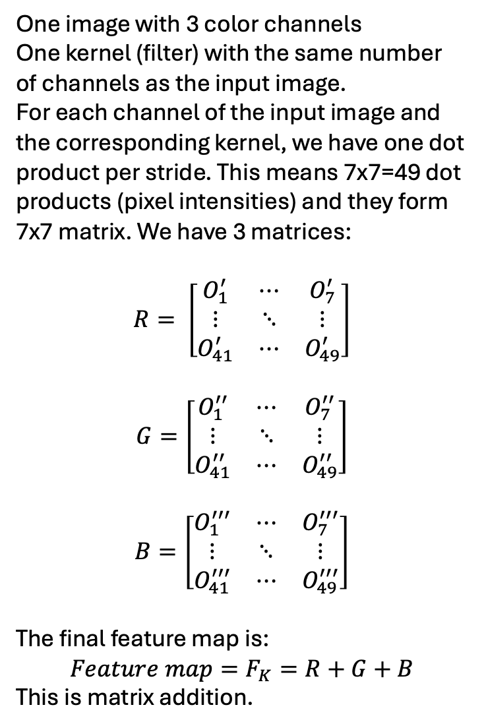
One image with 3 color channels
One kernel (filter) with the same number of channels as the input image.
For each channel of the input image and the corresponding kernel, we have one dot product per stride. This means 7x7=49 dot products (pixel intensities) and they form 7x7 matrix. We have 3 matrices:
$$R= \left[\begin{matrix}O_{1}^{′} & ⋯ & O_{7}^{′} \\ ⋮ & ⋱ & ⋮ \\ O_{41}^{′} & ⋯ & O_{49}^{′}\end{matrix}\right]$$
$$G=\left[\begin{matrix}O_{1}^{′′} & ⋯ & O_{7}^{′′} \\ ⋮ & ⋱ & ⋮ \\ O_{41}^{′′} & ⋯ & O_{49}^{′′}\end{matrix}\right]$$
$$B=\left[\begin{matrix}O_{1}^{′′′} & ⋯ & O_{7}^{′′′} \\ ⋮ & ⋱ & ⋮ \\ O_{41}^{′′′} & ⋯ & O_{49}^{′′′}\end{matrix}\right]$$
The final feature map is:
$$Feature map=F_{K}=R+G+B$$
This is matrix addition.
3 color chanels

Slide 17
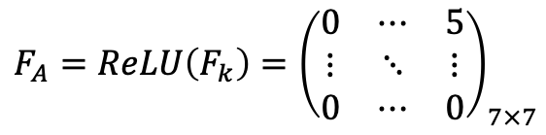
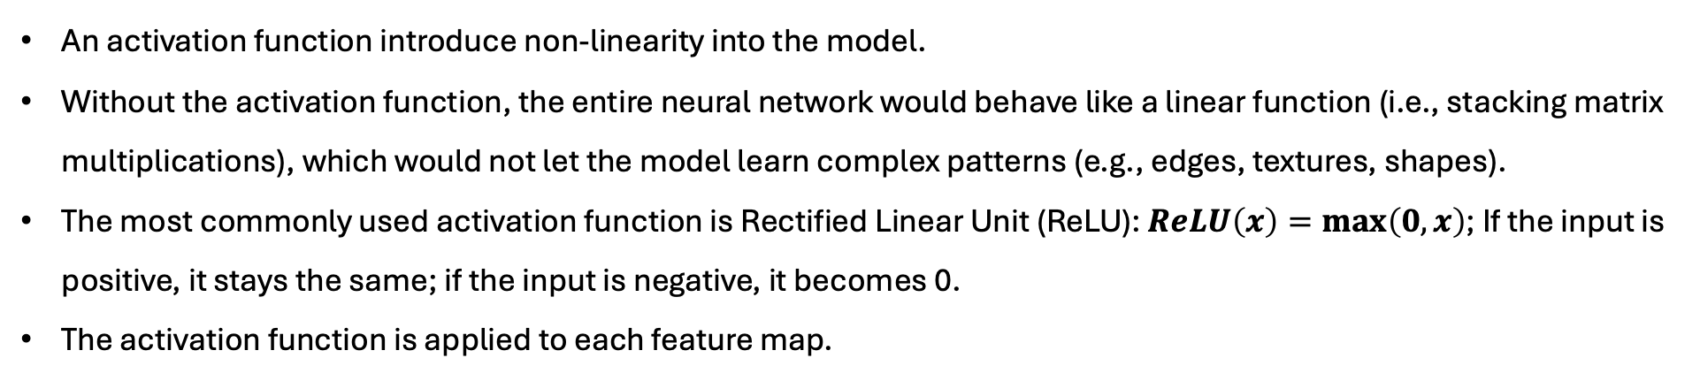
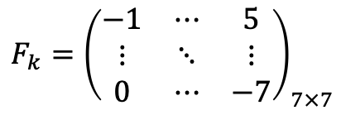
Applying Activation Function
An activation function introduce non-linearity into the model.
Without the activation function, the entire neural network would behave like a linear function (i.e., stacking matrix multiplications), which would not let the model learn complex patterns (e.g., edges, textures, shapes).
The most commonly used activation function is Rectified Linear Unit (ReLU): $ReLU\left(x\right)=\max\left(0,x\right)$; If the input is positive, it stays the same; if the input is negative, it becomes 0.
The activation function is applied to each feature map.
$$F_{k}={\left(\begin{matrix}−1 & ⋯ & 5 \\ ⋮ & ⋱ & ⋮ \\ 0 & ⋯ & −7\end{matrix}\right)}_{7×7}$$
$$F_{A}=ReLU\left(F_{k}\right)={\left(\begin{matrix}0 & ⋯ & 5 \\ ⋮ & ⋱ & ⋮ \\ 0 & ⋯ & 0\end{matrix}\right)}_{7×7}$$
Feature map
Activated feature map
The shape of the matrix stays the same after applying the activation function;
Negative values are converted to 0; This means ReLU removes negative noise (possibly irrelevant features are suppressed).
Positive values stay the same; ReLu function keeps important signls (strong positive activations are preserved).
Each feature map from the convolution layer is passed through ReLU.

Slide 18

Convolutional Neural Network
A type of DL neural network architecutre
Used in Computer Vision – a field of AI that enables a computer to understand and interpret the image or visual data
CNN architectue = input layer, Convolutional layer, Pooling layer, and fully connected layers.
Convolutional layer
Max pooling layer
Dense layer
Input layer
Output layer
Image

Slide 19
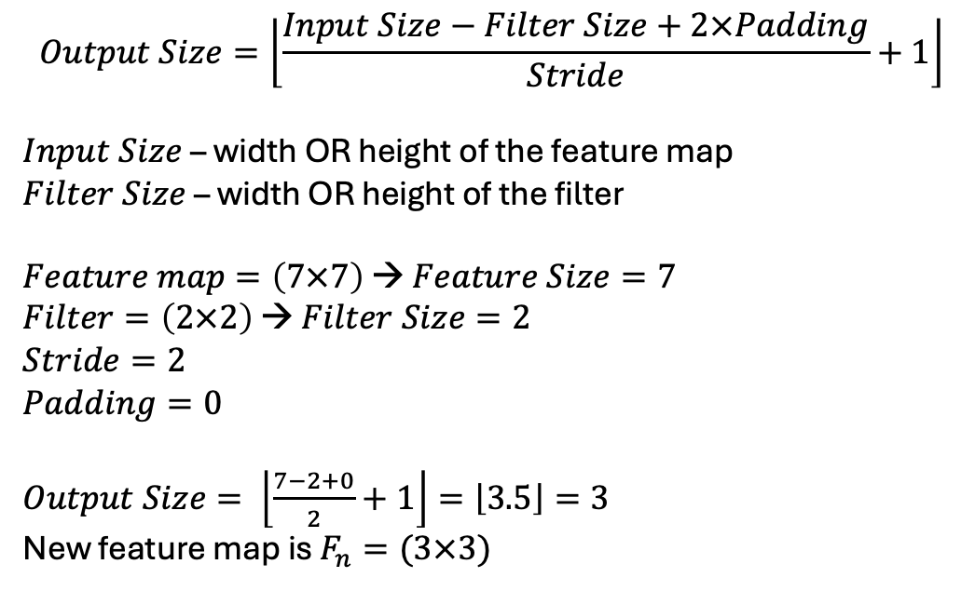
Pooling (Downsampling)
Pooling reduces the spatial dimensions (height and width) of the activated feature map.
This makes the model computationally efficient, reduces overfitting, and keep the most important features.
The most common type is Max Pooling, which takes the maximum value from a small region (patch) of the feature map. This keeps the strongest signal/feature from each region.
This is not a mathematical transformation like a convolution, but it is a purely selection-based operation in which we take the maximum value from the image (matrix patch).
$$Output Size=\left\lfloor \frac{Input Size−Filter Size+2×Padding}{Stride}+1\right\rfloor$$
$Input Size$– width OR height of the feature map
$Filter Size$ – width OR height of the filter
$Feature map=\left(7×7\right)$ → $Feature Size=7$
$Filter=\left(2×2\right)$ → $Filter Size=2$
$Stride=2$
$Padding=0$
$Output Size= \left\lfloor \frac{7−2+0}{2}+1\right\rfloor =\left\lfloor 3.5\right\rfloor =3$
New feature map is $F_{n}=(3×3)$
1 | 5
11 | 7
11

Slide 20
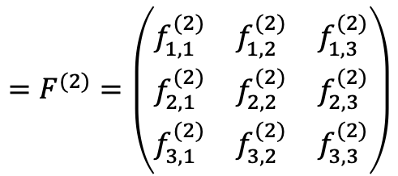
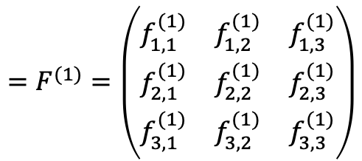
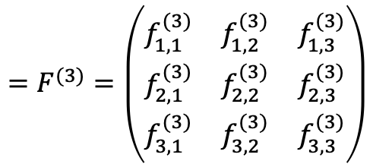
$$=F^{(1)}=\left(\begin{matrix}f_{1,1}^{(1)} & f_{1,2}^{(1)} & f_{1,3}^{(1)} \\ f_{2,1}^{(1)} & f_{2,2}^{(1)} & f_{2,3}^{(1)} \\ f_{3,1}^{(1)} & f_{3,2}^{(1)} & f_{3,3}^{(1)}\end{matrix}\right)$$
$$=F^{(2)}=\left(\begin{matrix}f_{1,1}^{(2)} & f_{1,2}^{(2)} & f_{1,3}^{(2)} \\ f_{2,1}^{(2)} & f_{2,2}^{(2)} & f_{2,3}^{(2)} \\ f_{3,1}^{(2)} & f_{3,2}^{(2)} & f_{3,3}^{(2)}\end{matrix}\right)$$
(9 x 9 x 3)
$$=F^{(3)}=\left(\begin{matrix}f_{1,1}^{(3)} & f_{1,2}^{(3)} & f_{1,3}^{(3)} \\ f_{2,1}^{(3)} & f_{2,2}^{(3)} & f_{2,3}^{(3)} \\ f_{3,1}^{(3)} & f_{3,2}^{(3)} & f_{3,3}^{(3)}\end{matrix}\right)$$
3 x (3 x 3 x 3)
3 x (7x7)
3 x (3x3)
Downsampling
Convolution + Activation

Slide 21


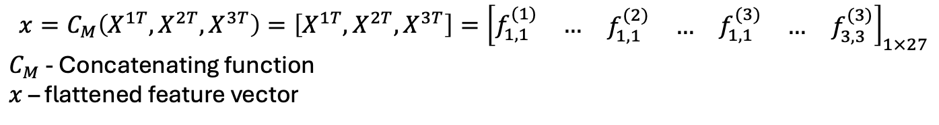

Flattening (Vectorization + Concatenation)
Fully connected (dense) layers expect a vector (1D input).
This layer converts a 3D layer in the network into a 1D vector
Since we had three 2D feature maps each 3x3 dimension, after flattening we will have 1D vector with 3x3x3=27 real numbers
Vectorization
$$vec\left(F^{\left(1\right)}\right)=X^{1}=\left[\begin{matrix}f_{1,1}^{(1)} \\ \begin{matrix}f_{1,2}^{(1)} \\ \begin{matrix}f_{1,3}^{(1)} \\ f_{2,1}^{(1)} \\ …\end{matrix}\end{matrix} \\ f_{3,3}^{(1)}\end{matrix}\right]∈ℝ^{9×1}$$
$$F^{(1)}=\left(\begin{matrix}f_{1,1}^{(1)} & f_{1,2}^{(1)} & f_{1,3}^{(1)} \\ f_{2,1}^{(1)} & f_{2,2}^{(1)} & f_{2,3}^{(1)} \\ f_{3,1}^{(1)} & f_{3,2}^{(1)} & f_{3,3}^{(1)}\end{matrix}\right)$$
$$X^{1T}=\left[\begin{matrix}f_{1,1}^{(1)} & \begin{matrix}f_{1,2}^{(1)} & f_{1,3}^{(1)} & \begin{matrix}f_{2,1}^{(1)} & …\end{matrix}\end{matrix} & f_{3,3}^{(1)}\end{matrix}\right]∈ℝ^{1×9}$$
1D vector
$$F^{(1)}∈ℝ^{3×3}$$
$${x=C}_{M}\left(X^{1T},X^{2T},X^{3T}\right)=\left[X^{1T},X^{2T},X^{3T}\right]={\left[\begin{matrix}f_{1,1}^{(1)} & … & \begin{matrix}\begin{matrix}f_{1,1}^{(2)} & …\end{matrix} & f_{1,1}^{(3)} & \begin{matrix}… & f_{3,3}^{(3)}\end{matrix}\end{matrix}\end{matrix}\right]}_{1×27}$$
$C_{M}$ - Concatenating function
$x$ – flattened feature vector

Slide 22
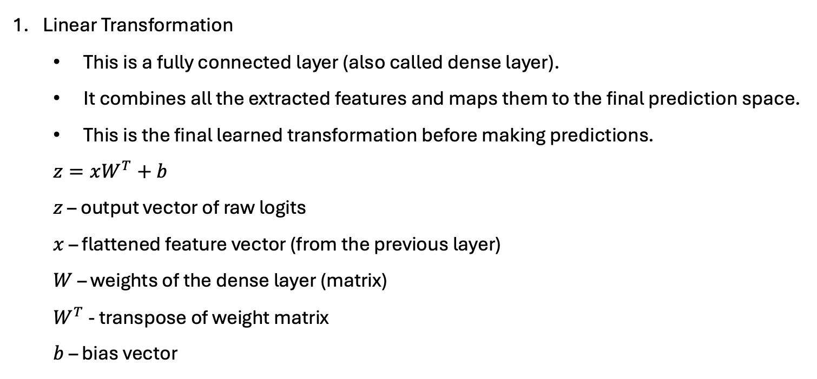
Fully Connected (Dense) Layer
Linear Transformation
  This is a fully connected layer (also called dense layer).
  It combines all the extracted features and maps them to the final prediction space.
  This is the final learned transformation before making predictions.
  $z=xW^{T}+b$
  $z$ – output vector of raw logits
  $x$ – flattened feature vector (from the previous layer)
  $W$ – weights of the dense layer (matrix)
  $W^{T}$ - transpose of weight matrix
  $b$ – bias vector
A weight matrix in a neural network is a matrix of trainable parameters that determine the strength of the connections between neurons.
Each weight controls how much influence a specific input has on the output.
A bias vector is a trainable vector added to the output of a neuron after the weighted sum, allowing the model to better fit the data by shifting the activation function.
Both weights and biases are updated during backpropagation using gradient descent to minimize the loss.

Slide 23
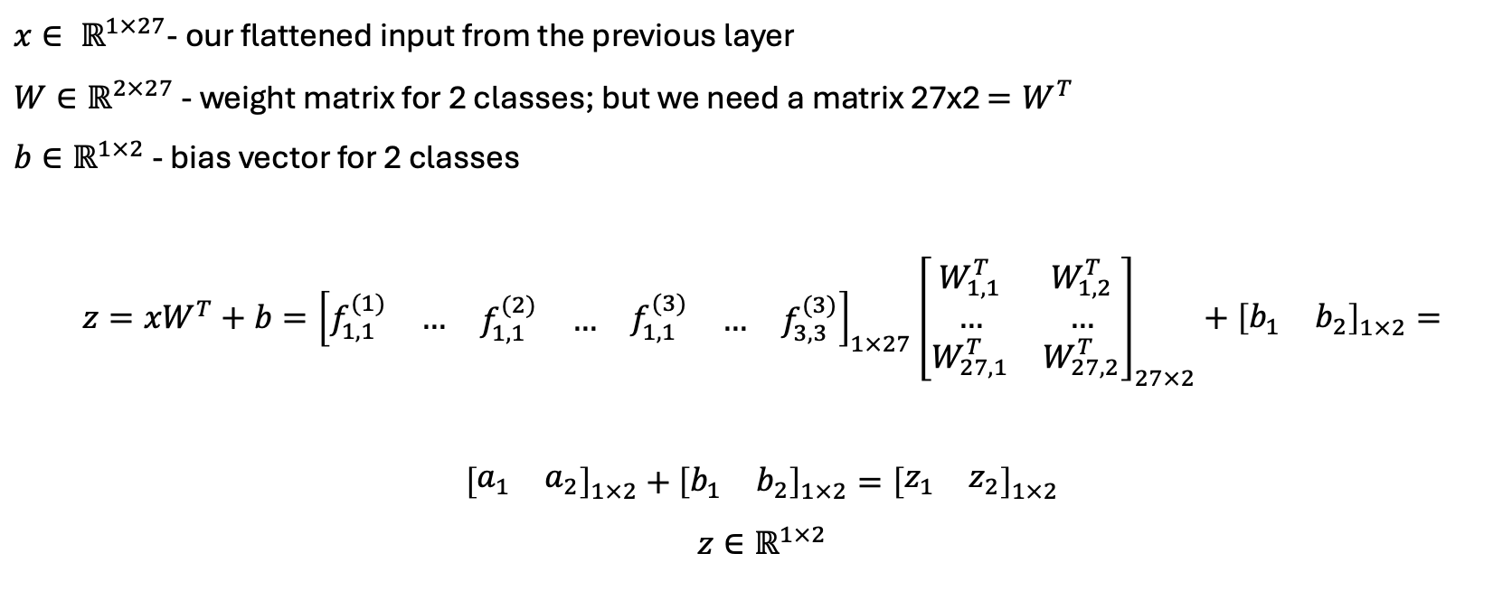
If we have 2 classes = meaning the model is trying to classify inputs into one of 2 possible categories (e.g., 2 types of objects), each class has a corresponding output neuron – so the final layer will output 2 values.
$x∈ ℝ^{1×27}$- our flattened input from the previous layer
$W∈ℝ^{2×27}$ - weight matrix for 2 classes; but we need a matrix 27x2 $=W^{T}$
$b∈ℝ^{1×2}$ - bias vector for 2 classes
$$z={xW}^{T}+b={\left[\begin{matrix}f_{1,1}^{(1)} & … & \begin{matrix}\begin{matrix}f_{1,1}^{(2)} & …\end{matrix} & f_{1,1}^{(3)} & \begin{matrix}… & f_{3,3}^{(3)}\end{matrix}\end{matrix}\end{matrix}\right]}_{1×27}{\left[\begin{matrix}W_{1,1}^{T} & W_{1,2}^{T} \\ … & … \\ W_{27,1}^{T} & W_{27,2}^{T}\end{matrix}\right]}_{27×2}+{\left[\begin{matrix}b_{1} & b_{2}\end{matrix}\right]}_{1×2}=$$
${\left[\begin{matrix}a_{1} & a_{2}\end{matrix}\right]}_{1×2}+$ ${\left[\begin{matrix}b_{1} & b_{2}\end{matrix}\right]}_{1×2}={\left[\begin{matrix}z_{1} & z_{2}\end{matrix}\right]}_{1×2}$
$$z∈ℝ^{1×2}$$
For $i$ classes we will have $i$ values (logits) as an output; the logits are the elements of a 1D vector $z$

Slide 24
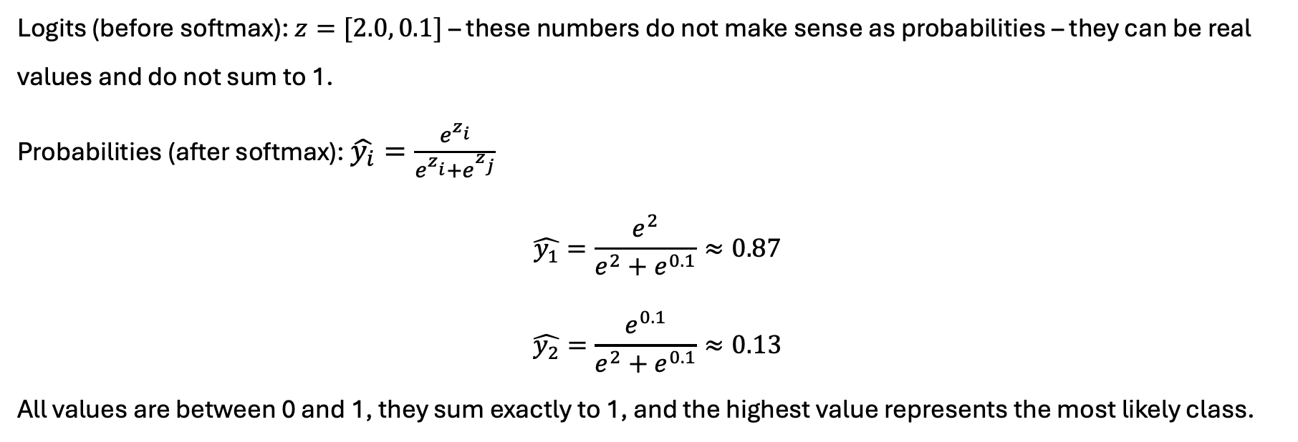
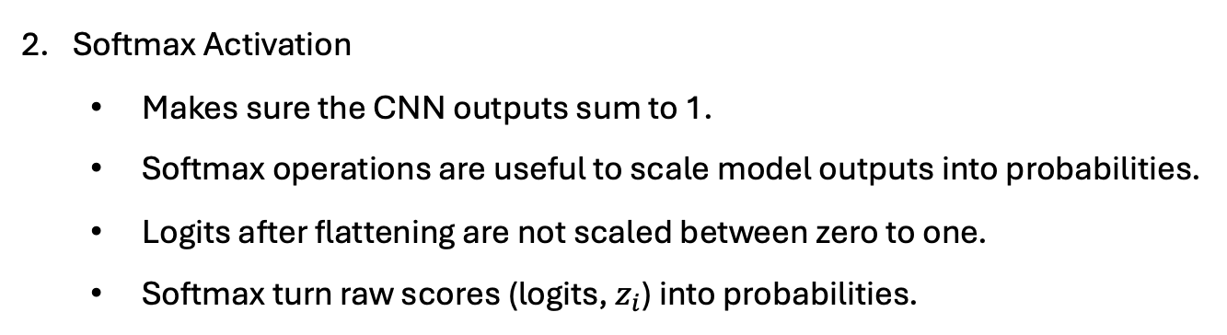
Fully Connected (Dense) Layer
Softmax Activation
  Makes sure the CNN outputs sum to 1.
  Softmax operations are useful to scale model outputs into probabilities.
  Logits after flattening are not scaled between zero to one.
  Softmax turn raw scores (logits, $z_{i}$) into probabilities.
Logits (before softmax): $z=[2.0, 0.1]$ – these numbers do not make sense as probabilities – they can be real values and do not sum to 1.
Probabilities (after softmax): $\hat{y_{i}}=\frac{e^{z_{i}^{ }}}{e^{z_{i}^{ }}+e^{z_{j}^{ }}}$
$$\hat{y_{1}}=\frac{e^{2}}{e^{2}+e^{0.1}}≈0.87$$
$$\hat{y_{2}}=\frac{e^{0.1}}{e^{2}+e^{0.1}}≈0.13$$
All values are between 0 and 1, they sum exactly to 1, and the highest value represents the most likely class.
The model is 87% confident in class 1

Slide 25
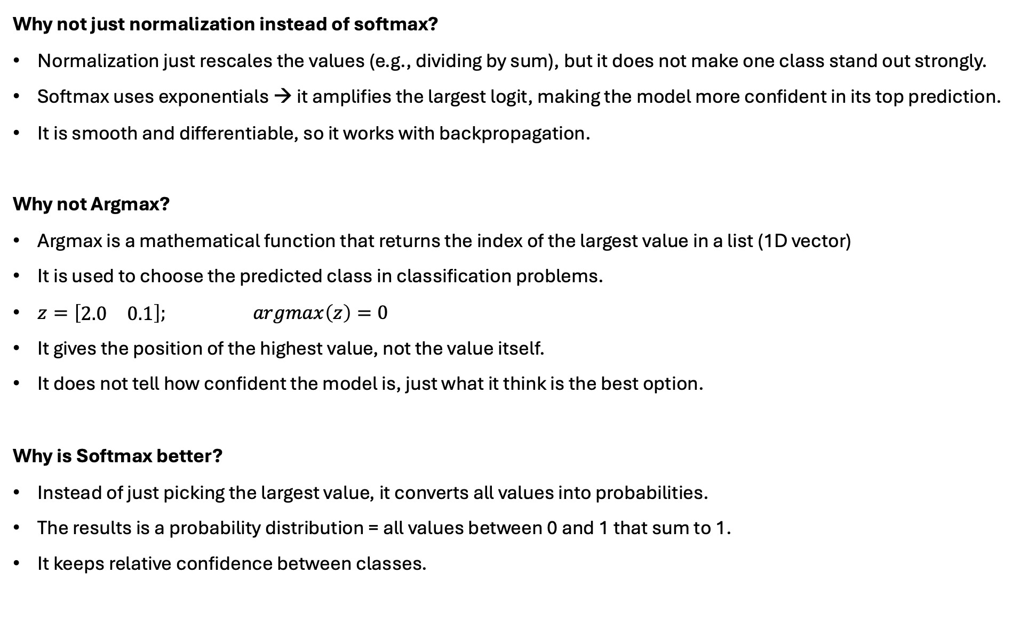
Why not just normalization instead of softmax?
Normalization just rescales the values (e.g., dividing by sum), but it does not make one class stand out strongly.
Softmax uses exponentials → it amplifies the largest logit, making the model more confident in its top prediction.
It is smooth and differentiable, so it works with backpropagation.
Why not Argmax?
Argmax is a mathematical function that returns the index of the largest value in a list (1D vector)
It is used to choose the predicted class in classification problems.
$z=\left[\begin{matrix}2.0 & 0.1\end{matrix}\right];$ $argmax\left(z\right)=0$
It gives the position of the highest value, not the value itself.
It does not tell how confident the model is, just what it think is the best option.
Why is Softmax better?
Instead of just picking the largest value, it converts all values into probabilities.
The results is a probability distribution = all values between 0 and 1 that sum to 1.
It keeps relative confidence between classes.

Slide 26
What happens after Softmax?
Once softmax gives us the predicted probabilities, we have:
  Loss Computation – calculation of the loss (error) using a suitable loss function like Cross-Entropy.
  Gradient Calculation – use of gradient descent to compute how much each weight and bias contributed to the error – this gives us the gradients.
  Backpropagation – propagate the error backward through the network to update all the weights and biases (including convolutional kernels).
  This cycle repeats for many epochs to improve the model.

Slide 27
Session 1. Introduction to Convolutional Neural Networks (CNNs)
2. Types of CNN architectures and design
CNNs have evolved from simple image classifiers to deep, modular systems for visual understanding
  From digit recognition (LeNet-5) to object detection, segmentation, and even video and medical imaging
Transition of architectural complexity:
  LeNet5 (1998) → AlexNet (2012, deep + GPU) → VGG (uniform blocks) → ResNet (residuals) → EfficientNet (scaling laws + optimization)
Architectural innovations are driven by hardware evolution (e.g., GPUs, TPUs) and algorithmic breakthroughs (e.g., ReLU, BatchNorm, skip connections)
Modern designs prioritize trade-offs between accuracy, latency, and energy consumption
  This is critical for real-world deployments (e.g., autonomous driving, mobile devices, medical diagnostics)

Slide 28
Model | Year | Key Feature | Params
LeNet-5 | 1998 | First CNN prototype | ~ 60K
AlexNet | 2012 | ReLU, dropout, GPU training | ~ 60M
VGG16 | 2014 | Deep with 3x3 conv layers | ~ 135M
ResNet50 | 2015 | Residual skip connections | ~ 25M
EfficientNet | 2019 | Compund scaling, optimized | ~ 5M – 65M

Slide 29
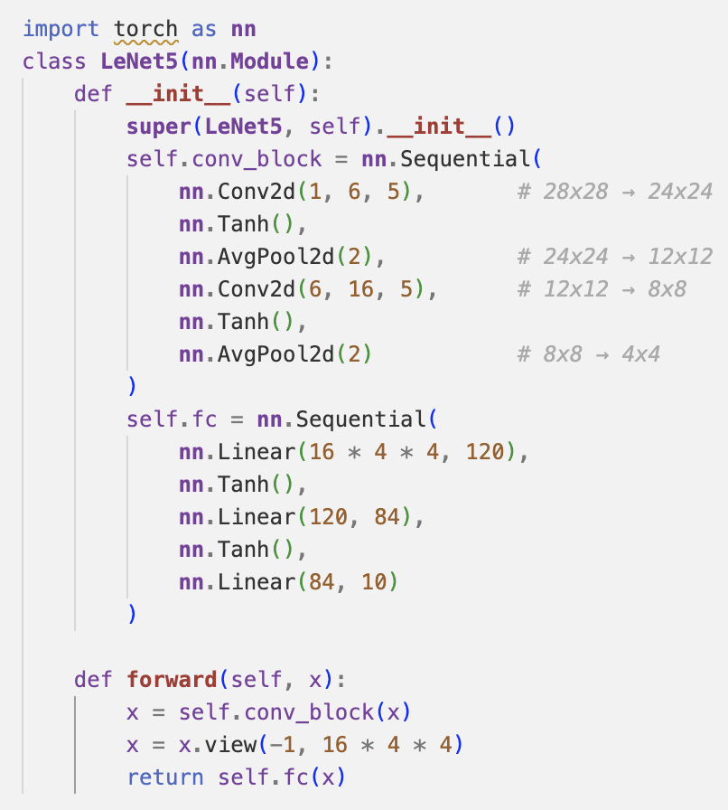
1. LeNet-5 (1998)
Purpose: Digit classification (MNIST)
Input size: 32×32 grayscale
Architecture depth: Very shallow
Key features:
Uses tanh activation functions.
Has only 2 convolutional layers followed by pooling.
Small number of parameters (~60K).
Uses average pooling, not max pooling.
Designed to run on CPUs — no GPU consideration.

Slide 30

2. AlexNet-5 (2012)
Purpose: ImageNet classification
Input size: 224×224 RGB
Architecture depth: Deep for its time (5 conv + 3 FC layers)
Key innovations:
Introduced ReLU (faster convergence than tanh).
Used GPU acceleration.
Employed dropout to reduce overfitting.
Used overlapping max pooling.
Significantly more parameters (~60M).

Slide 31

3. VGGNet (2014)
Purpose: ImageNet classification
Input size: 224×224 RGB
Architecture depth: Deeper than AlexNet (up to 19 layers)
Key design:
Stacks of 3×3 convolutional layers (uniform filter size).
Simpler architecture — repeated blocks with increasing filters (64 → 512).
Trained on GPUs, has massive parameter count (~138M for VGG-16).
Uses only max pooling and ReLU, no batch normalization in original.

Slide 32
4. GoogLeNet (Inception2014)
Key Innovations:
Introduced the Inception module: parallel convolutions with different kernel sizes (1×1, 3×3, 5×5) + max pooling, all concatenated into a single output.
Used 1×1 convolutions for dimensionality reduction.
Reduced computation vs. VGGNet while increasing depth to 22 layers.
Removed fully connected layers, replacing them with global average pooling.
Key difference: Introduced the idea of multi-scale feature extraction within a single layer using parallel branches. Highly optimized for efficiency and speed.

Slide 33
5. ResNet (Residual Networks, 2015)
Key Innovations:
Introduced residual blocks with identity skip connections:
Enables training of very deep networks (50, 100, 150+ layers).
Solves the vanishing gradient problem by allowing gradients to flow directly through shortcut connections.
Achieved state-of-the-art ImageNet performance.
Key difference: Allowed training of extremely deep networks by making them easier to optimize. Skip connections are now standard in deep CNNs and transformers.

Slide 34
CNN Design Consideration
1. Depth vs. Width
Depth: More layers → higher abstraction power, but risk of vanishing gradients and overfitting.
Width: More channels per layer → richer feature representation, but heavier computation and memory usage.
Trade-off: Shallow & wide models may converge faster; deep & narrow may generalize better with skip connections.
2. Kernel Size
3x3 kernels: Standard for hierarchical feature extraction;
1x1 kernels: Used for dimension reduction;
Larger kernels (e.g., 5x5, 7x7): Capture broader context, but expensive.
Dilated convolutions: Expand receptive field without increasing parameters.
3. Pooling Layers
Max pooling: Selects strongest activation → better for sparse features.
Average pooling: Smooths features → better for dense patterns.
Global average pooling: Replaces fully connected layers → reduces overfitting and parameters.

Slide 35
CNN Design Consideration
4. Normalization Techniques
BatchNorm: Normalizes across mini-batch; accelerates convergence, stabilizes gradients.
LayerNorm / GroupNorm: Better for small batch sizes or non-vision tasks.
WeightNorm / InstanceNorm: Specialized variants used in style transfer, GANs.
5. Activation Functions
ReLU: Fast, simple, sparsity-inducing; standard choice.
Swish: Smooth and non-monotonic; performs better in deep models.
GELU: Used in transformers; combines linearity and stochastic regularization.
6. Skip Connections
Identity mappings in ResNet allow gradients to bypass layers.
Alleviates vanishing gradients, improves convergence speed.
Essential for training deep architectures (50+ layers).
Dense connections (DenseNet) generalize this idea.

Slide 36
Session 1. Introduction to Convolutional Neural Networks (CNNs)
3. Use cases
Image Classification
  CNNs dominate image recognition tasks
  Used in autonomous driving, surveillance, …
Object Detection
  Locate and classify multiple object in an image
Semantic Segmentation
  Classifies each pixel in an image
  Applied in self-driving cars, agriculture, satellite imaging
Medical imaging
  Disease detection in X-rays, MRIs, and CT scans
  CNNs outperform traditional diagnostics in some domains
Facial recognition and biometrics
  Face detection, verificaiton, emotion recognition
  Applications: security, identity verification, affective computing
Document and text recognition
  Handwriting recognition, OCR, license plate reading
  CNNs extract spatial character patterns efficiently
Video analysis
  Activity recognition, anomaly detection
Scientific and industrial use

Slide 37
Session 1. Introduction to Convolutional Neural Networks (CNNs)
4. Challenges
1. Data Requirements
CNNs need large labelled datasets to avoid overfitting.
2. Computational Cost
High training time and memory footprint.
Need for GPUs/TPUs or HPC resources for deep or large-scale models.
3. Interpretability
CNNs are often black boxes; difficult to explain decisions.
Techniques like Grad-CAM are used for visualization, but not always sufficient.
4. Overfitting
Especially problematic with small datasets or deep networks.
Needs dropout, data augmentation, early stopping, etc.
5. Adversarial Vulnerability
CNNs are sensitive to small, imperceptible perturbations.
Raises concerns in security-critical applications.
6. Generalization and Transferability
Models trained on one domain often fail to generalize to others.
Domain adaptation and self-supervision are partial solutions.
7. Deployment Constraints
Model size and inference latency can be bottlenecks for edge or real-time systems.

Slide 38
Session 1. Introduction to Convolutional Neural Networks (CNNs)
Exercise: Designing a simple CNN in TensorFlow
Objective: Train and compare several convolutional neural networks on CIFAR-10 using TensorFlow, and benchmark performance on HPC resources.
Learning Goals:
Understand architectural choices: depth, batch norm, dropout, etc.
Compare training time and validation accuracy.
Generate and interpret confusion matrices and prediction grids.
Export metrics and analyze influence of model complexity.
Key Steps:
Load and normalize CIFAR-10
Define four CNN models with increasing complexity
Train with callbacks (timing, early stopping, LR scheduling)
Log and save metrics per model
Compare validation accuracy/loss and confusion matrices
Visualize predictions using sample grid plots

Slide 39
Session 2. HPC Fundamentals for Deep Learning
1. Essentials of HPC architecture
What is HPC?
High-Performance Computing (HPC) is the use of aggregated computing power—typically thousands of CPU/GPU cores—to solve complex computational problems in parallel.
Architecture Breakdown
Compute nodes: Machines with CPUs, memory, and optionally GPUs.
Interconnect: Ultra-fast communication fabric (e.g., InfiniBand, NVLink) enabling data sharing between nodes.
Head/Login node: Where users log in, submit jobs, and access the filesystem.
Storage: Parallel file systems (e.g., Lustre, GPFS) shared across nodes.
SLURM Scheduler
Manages job queues, resources, and execution on HPC clusters.
User submits jobs via SLURM scripts (sbatch, srun, etc.).

Slide 40
Understanding the SLURM Scheduler in HPC
What is SLURM?
SLURM (Simple Linux Utility for Resource Management) is a widely-used, open-source workload manager for HPC clusters.
Acts as the job scheduling system, responsible for:
  Allocating compute resources
  Queuing jobs
  Managing execution
  Handling job dependencies and priorities
Why Do We Need a Scheduler?
HPC clusters serve multiple users and jobs simultaneously.
Resources (CPUs, GPUs, memory) are finite.
SLURM ensures fair, efficient, and prioritized usage of the cluster.

Slide 41

Basic SLURM Workflow
User writes a job script (shell script with SLURM directives)
Submit job: sbatch my_job.sh
SLURM queues and dispatches the job to available nodes
Job runs with specified resources
Output is saved to log files or user-defined paths

Slide 42
Why and When to Use HPC for Deep Learning?
Deep Learning, particularly with CNNs and large-scale models, is both:
Data-intensive: Training datasets like ImageNet or video data often exceed hundreds of GBs.
Compute-heavy: Models may contain millions to billions of parameters—demanding powerful accelerators and fast interconnects.
HPC enables scalable training through:
Multi-GPU parallelism: Drastically reduces training time by distributing computation.
Multi-node scaling: Handles models and batch sizes that exceed single-node memory limits.
Concurrent experimentation: Essential for hyperparameter tuning, architecture search, and reproducibility under high load.

Slide 43
When Is HPC a Must?
Scenario | Why HPC Is Needed?
Training deep models | E.g., ResNet-152, EfficientNet, transformers — require significant GPU memory and compute
Hyperparameter tuning / Neural Architecture Search | Run hundreds of models in parallel to explore search space efficiently
Research workloads | Academic labs and industry R&D teams often share infrastructure — multi-user support, quotas, job scheduling.
Long training cycles | Jobs that run for days to weeks must be scheduled and checkpointed robustly.

Slide 44
Session 2. HPC Fundamentals for Deep Learning
2. GPU vs CPU for Deep Learning
CPUs
General-purpose processors.
Designed for a mix of sequential and parallel execution (multi-core + multi-threaded).
Best for:
Data preprocessing
Control-heavy logic
Scheduling, file I/O, and orchestration
GPUs
Thousands of smaller cores for massively parallel workloads.
Designed to accelerate operations like:
Matrix multiplications
Tensor operations
Convolutions

Slide 45
Deep Learning Workload Mapping
Task | Ideal Hardware | Reason
Data loading + augmentation | CPU | I/O-bound, control-heavy
Forward + backward pass (training) | GPU | Parallelized matrix operations
Loss function computation | GPU | Element-wise ops, fast with vectorization
Parameter updates (optimizers) | GPU | Low compute but frequent; better on-GPU
Logging + metric aggregation | CPU | Minimal compute, works asynchronously

Slide 46
When to Use GPUs Over CPUs
Training
Always prefer GPUs (1–100x speedup).
Multi-GPU setups reduce epoch time and allow for bigger batch sizes.
Inference
Small models (e.g., on edge): CPU might suffice.
Large models or real-time: GPU is preferable.
Bottlenecks to Watch
GPU underutilization due to:
  Data loader slowness (fix with num_workers)
  Small batch sizes
  CPU-bound bottlenecks (e.g., image decoding)

Slide 47
Session 2. HPC Fundamentals for Deep Learning
3. Storage and I/O bottlenecks
HPC systems typically offer multiple tiers of storage optimized for different use cases:
Tier | Example | Characteristics | Usage
Scratch | /scratch, node-local SSD | Temporary, fast, job-local | Training data, caching
Project | /project, NFS or GPFS | Medium-speed, persistent | Model outputs, shared datasets
Archive | /archive, tape | Slow, long-term | Backup, publication datasets
Isilon | /isilon, shared NAS | High-capacity, moderate-speed, shared | General user storage, I/O-bound reads

Slide 48
Storage Bottlenecks in Deep Learning
Challenges
Deep learning workloads often do:
  Random access (e.g., image shuffling, augmentations)
  Concurrent reads (from multiple workers or nodes)
If many jobs read from shared storage (e.g., Isilon) → leads to:
  High latency
  Throughput degradation
  Occasional I/O throttling
Symptoms of I/O Bottlenecks
GPU underutilization (e.g., 20% usage)
num_workers does not help
Stalled training despite idle compute

Slide 49
Best Practices
Optimize Data Placement
Copy dataset to scratch during job start (local or parallel file system).
Avoid streaming large datasets directly from /isilon.
Use Efficient Data Formats
Convert datasets to:
TFRecord (TensorFlow)
HDF5 or WebDataset (PyTorch)
These reduce file system overhead and speed up batched loading.
Parallel Data Loading
Use high num_workers in DataLoader, but test empirically.
Pre-cache transformations and prefetch data to GPU when possible.

Slide 50
Session 2. HPC Fundamentals for Deep Learning
4. Scaling strategies
The Problem
Modern deep learning models are:
  Data-hungry: Training datasets (e.g., ImageNet, LAION-5B) reach terabyte scale.
  Memory-intensive: Models like GPT-3 require hundreds of GBs of GPU memory.
  Time-consuming: Even with 1 GPU, training may take days to weeks.
The Need to Scale
Single GPU is no longer sufficient for:
Large models (ResNet-152, EfficientNet-L2, LLMs)
Real-time or production pipelines
Hyperparameter tuning or Neural Architecture Search
HPC Enables:
Multi-GPU training: Across 1 node (intra-node scaling)
Multi-node training: Across dozens to hundreds of nodes
Concurrent experiments: Grid search, population-based training, federated workloads

Slide 51
Data Parallelism
Concept
Replicate the model on each GPU.
Each replica processes a different mini-batch of data.
Gradients are aggregated (e.g., via NCCL backend).
Libraries
PyTorch: torch.nn.parallel.DistributedDataParallel (DDP)
TensorFlow: tf.distribute.MultiWorkerMirroredStrategy
Pros & Use Case
Scales easily across GPUs and nodes.
Ideal for image classification, NLP, general CNN/RNN workloads.

Slide 52
Model Parallelism
Concept
Split parts of the model architecture across multiple GPUs.
E.g., layer 1 on GPU0, layer 2 on GPU1
Data moves sequentially through GPUs.
Use Case
Very large models (e.g., GPT-3, LLaMA, Megatron-LM).
When the model doesn’t fit in a single GPU’s memory.
Trade-offs
More complex to implement and debug.
May have communication bottlenecks between layers.
Rare in CNNs, common in extreme-scale LLMs.

Slide 53
Mixed Precision Training
Concept
Use FP16 (16-bit floats) instead of full FP32.
Reduces memory usage and speeds up matrix operations on Tensor Cores.
Benefits
Train larger models or batch sizes with same hardware.
Achieve 30–50% speedups on modern GPUs (e.g., NVIDIA A100, V100).
Libraries
PyTorch: torch.cuda.amp
TensorFlow: tf.keras.mixed_precision
Use mixed precision whenever possible—especially with modern NVIDIA GPUs.

Slide 54
Session 2. HPC Fundamentals for Deep Learning
Exercise: SLURM job submission for training a DL model (CPU vs GPU)
Objective: compare the performance of training a deep convolutional neural network (CNN) using SLURM on two hardware configurations:
CPU-only execution
GPU-accelerated execution
Understand the practical impact of hardware acceleration on deep learning workloads using PyTorch and CIFAR-10.
Model: Reuse Model4, a multi-layer CNN originally defined in Exercise 1.
Dataset: CIFAR-10, loaded and normalized.
Framework: PyTorch, with optimized DataLoader setup (multi-core CPU, pin_memory for GPU).
Training: Run for 20 epochs and measure total training time.
You will write and submit two SLURM batch scripts:
exc2_cpu.sh: Runs on a CPU partition (e.g., --partition=cpu)
exc2_gpu.sh: Runs on a GPU partition with --gres=gpu:1

Slide 55
Session 3. Scalable CNN training with Distributed Data Parallel (DDP) on HPC
1. How DDP works?
DistributedDataParallel (DDP) is PyTorch’s high-performance, production-ready method for multi-GPU/multi-node training.
Core Concept:
Each process gets its own model replica on a different GPU.
Gradients are synchronously averaged across processes using NCCL or Gloo backends.
Workflow Overview:
One process per GPU.
Dataset is partitioned with DistributedSampler.
Forward pass → backward pass → all-reduce → optimizer step.
Key Advantages:
Near-linear scaling across GPUs.
Lower communication overhead than DataParallel.
Fully supports SLURM-managed multi-node training.

Slide 56
Session 4. Optimization and Benchmarking
1. Optimization of the training and best practices
Optimization in DL is not just about faster training – it is about making your models efficient, scalable, and production-ready.
1. Reduce Training Time and Resource Usage
Efficient use of GPUs and CPUs shortens training cycles.
Optimized data pipelines reduce I/O bottlenecks.
Mixed precision training can cut memory usage and speed up computation.
2. Improve Model Accuracy and Generalization
Proper learning rate schedules and regularization techniques help avoid overfitting.
Optimized architectures (e.g., fewer parameters, better layer design) can generalize better on unseen data.
3. Enable Reproducibility and Deployment
Exporting trained models in a consistent format (e.g., .pt, .onnx) ensures they can be reused or deployed.
Reproducible training pipelines are critical for scientific research and production environments.
4. Essential for Scaling on HPC Systems
HPC clusters are designed for parallelism — optimization ensures your code scales across multiple GPUs or nodes.
Poorly optimized code can underutilize hardware, leading to wasted compute hours and longer queues.
5. Real-World impact
A well-optimized model might train in half the time and use 30–50% less memory.
In production, optimized inference can reduce latency from seconds to milliseconds.

Slide 57
Training Optimization Techniques
1. Mixed Precision Training
Uses both 16-bit and 32-bit floating point operations.
Reduces memory usage and speeds up training on GPUs with Tensor Cores
Enabled in PyTorch via: torch.cuda.amp.autocast()
2. Learning Rate Scheduling
Dynamically adjusts the learning rate during training to improve convergence.
Common schedulers:
  StepLR: Reduces LR at fixed intervals.
  CosineAnnealingLR: Smooth decay following a cosine curve.
  ReduceLROnPlateau: Reduces LR when a metric stops improving.
3. Gradient Clipping
Prevents exploding gradients in deep networks.
Stabilizes training, especially in RNNs or deep CNNs.
Enabled in PyTorch via torch.nn.utils.clip_grad_norm_(model.parameters(), max_norm=1.0)
4. Batch Size and Data Loading
Larger batch sizes improve GPU utilization but require more memory.
Use num_workers to parallelize data loading.
Enable pin_memory=True to speed up host-to-GPU transfers.

Slide 58
Benchmarking Your Model
Benchmarking helps you understand how efficiently your model uses compute resources and how training performance scales. It’s essential for:
Identifying bottlenecks, Comparing optimization strategies, Justifying resource usage on HPC systems
Key Metrics to Track:
Training Time per Epoch
Measures how long each epoch takes.
Helps compare different model versions or hardware setups.
GPU Utilization
Use nvidia-smi to monitor real-time GPU usage.
PyTorch Profiler can show GPU kernel execution timelines.
Memory Usage
Track GPU memory allocation to avoid out-of-memory errors.
Helps tune batch size and model complexity.
Accuracy vs. Time Trade-off
Balance between training speed and model performance.
Useful for early stopping and model selection.

Slide 59
Session 4. Optimization and Benchmarking
2. Reproducible model export
Why Export Your Model?
Exporting trained models is a critical step for:
Sharing across teams: Collaborators can load and test the model without retraining.
Reusing for inference or fine-tuning: Save time by building on existing work.
Ensuring reproducibility: Store exact model weights and architecture for future validation or publication.
Export Only the Weights (Recommended for Flexibility)
Saves only the learned parameters
Requires the model architecture to be redefined when loading
Export the Entire Model (Less Flexible)
Saves both the architecture and weights
Easier to load, but less portable across environments

Slide 60
Session 4. Optimization and Benchmarking
3. Post-training inference testing
Inference testing ensures that the trained model performs well in real-worls scenarios.
Validation of:
Model accuracy on unseen data
Latency and performance on target hardware
Readiness for deployment
Key steps in inference testing:
Load the trained model
  Load saved weights or the full model for disk
Switch to evaluation mode
  Disables dropout and batch norm updates
  Ensures consistent behaviour during inference
Run inference on test data
  Use torch.no_grad() to disable gradient tracking
  Pass the test data through the model and collect predictions
Measure latency and accuracy
  Use time.time() to measure inference duration
  Compare predictions to ground truth to compute accuracy

Slide 61
Summary
Why it matters?
Researchers can iterate faster and explore more ideas.
Engineers can deploy models that are better trained and more robust.
Organizations can scale AI solutions without bottlenecks.
What HPC brings to Deep Learning?
Massive Parallelism
Faster Training
Efficient Resource Utilization
Large-Scale Data handling

